Slide 1
CHAPTER 5 The Five Generic Competitive Strategies

Slide 2
LEARNING OBJECTIVES
THIS CHAPTER WILL HELP YOU UNDERSTAND:
What distinguishes each of the five generic strategies and why some of these strategies work better in certain kinds of competitive conditions than in others
The major avenues for achieving a competitive advantage based on lower costs
The major avenues to a competitive advantage based on differentiating a company’s product or service offering from the offerings of rivals
The attributes of a best-cost provider strategy—a hybrid of low-cost provider and differentiation strategies

Slide 3
WHY DO STRATEGIES DIFFER?
A firm’s competitive strategy deals exclusively with the specifics of its efforts to position itself in the market-place, please customers, ward off competitive threats, and achieve a particular kind of competitive advantage.
Is the firm’s market target broad or narrow?
Key factors that distinguish one strategy from another
Is the competitive advantage pursued linked to low costs or product differentiation?
Jump to Appendix 1 long image description

Slide 4
THE FIVE GENERIC COMPETITIVE STRATEGIES
Low-cost provider | Striving to achieve lower overall costs than rivals on products that attract a broad spectrum of buyers
Broad differentiation | Differentiating the firm’s product offering from rivals’ with attributes that appeal to a broad spectrum of buyers
Focused low-cost | Concentrating on a narrow price-sensitive buyer segment and on costs to offer a lower-priced product
Focused differentiation | Concentrating on a narrow buyer segment by meeting specific tastes and requirements of niche members
Best-cost provider | Giving customers more value for the money by offering upscale product attributes at a lower cost than rivals

Slide 5
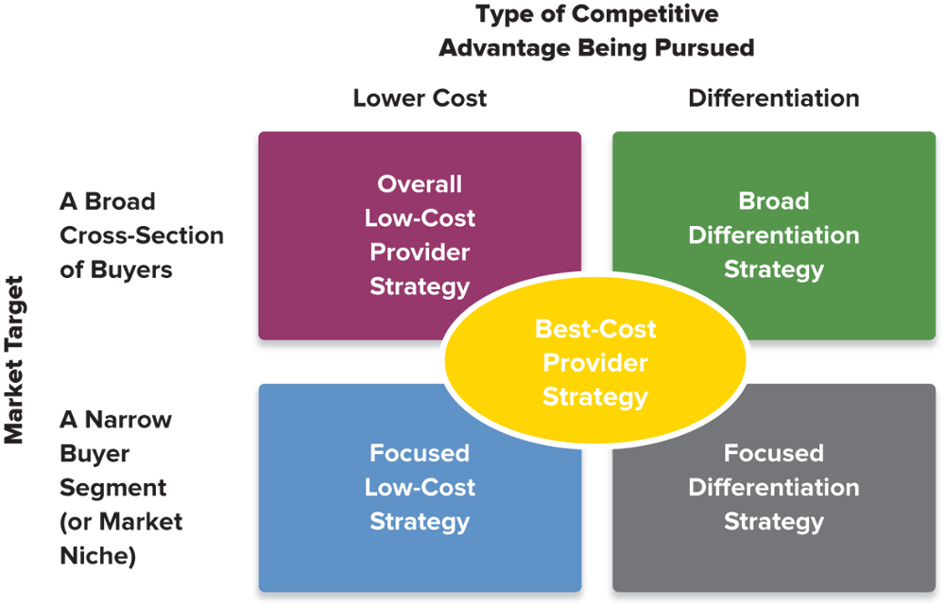
FIGURE 5.1 The Five Generic Competitive Strategies
Jump to Appendix 2 long image description

Slide 6
LOW-COST PROVIDER STRATEGIES
Effective low-cost approaches
Pursue cost savings that are difficult to imitate
Avoid reducing product quality to unacceptable levels
Competitive advantages and risks
Greater total profits and increased market share gained from underpricing competitors
Larger profit margins when selling products at prices comparable to and competitive with rivals
Low pricing does not attract enough new buyers
Rival’s retaliatory price-cutting sets off a price war

Slide 7
Core CONCEPTS (1 of 5)
A low-cost provider’s basis for competitive advantage is lower overall costs than competitors.
Successful low-cost leaders, who have the lowest industry costs, are exceptionally good at finding ways to drive costs out of their businesses and still provide a product or service that buyers find acceptable.
A cost driver is a factor that has a strong influence on a firm’s costs.

Slide 8
STRATEGIC MANAGEMENT PRINCIPLE (1 of 7)
A low-cost advantage over rivals can translate into better profitability than rivals attain.

Slide 9
MAJOR AVENUES FOR ACHIEVING A COST ADVANTAGE
Low-cost advantage
Cumulative costs across the overall value chain must be lower than competitors’ cumulative costs.
How to gain a low-cost advantage
Perform value-chain activities more cost-effectively than rivals
Revamp the firm’s overall value chain to eliminate or bypass cost-producing activities

Slide 10
Core Concept (2 of 5)
A cost driver is a factor that has a strong influence on a company’s costs.

Slide 11
COST-EFFICIENT MANAGEMENT OF VALUE CHAIN ACTIVITIES
Cost driver
A factor with a strong influence on a firm’s costs
Can be asset-based or activity-based
Securing a cost advantage
Use lower-cost inputs and hold minimal assets
Offer only “essential” product features or services
Offer only limited product lines
Use low-cost distribution channels
Use the most economical delivery methods

Slide 12
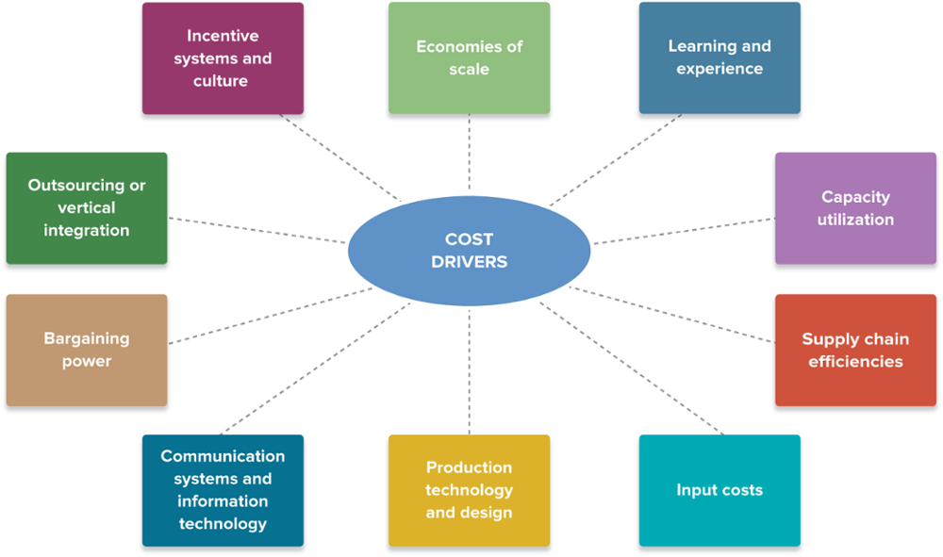
FIGURE 5.2 Cost Drivers: The Keys to Driving Down Company Costs
Jump to Appendix 3 long image description

Slide 13
COST-CUTTING METHODS (1 of 2)
Capturing all available economies of scale
Taking full advantage of experience and learning-curve effects
Operating facilities at full or near-full capacity
Improving supply chain efficiency
Substituting lower-cost inputs wherever there is little or no sacrifice in product quality or performance
Using the firm’s bargaining power vis-à-vis suppliers or others in the value chain system to gain concessions
Using online systems and sophisticated software to achieve operating efficiencies

Slide 14
COST-CUTTING METHODS (2 of 2)
Improving process design and employing advanced production technology
Being alert to the cost advantages of outsourcing or vertical integration
Motivating employees through incentives and company culture

Slide 15
REVAMPING THE VALUE CHAIN SYSTEM TO LOWER COSTS
Selling direct to consumers and bypassing the activities and costs of distributors and dealers by using a direct sales force and a company website
Streamlining operations to eliminate low value-added or unnecessary work steps and activities
Reduce materials handling and shipping costs by having suppliers locate their plants or warehouses close to the firm’s own facilities

Slide 16
How Walmart Managed Its Value Chain to Achieve a Huge Low-Cost Advantage over Rival Supermarket Chains
Which Walmart value chain activity would be most easily overcome by rival supermarket chains?
Which Walmart value chain activities would be the most difficult to overcome by rival supermarket chains?
Assume you have been tasked to revamp a rival supermarket’s value chain activities to better compete with Walmart. In what order of expected payoff should you attempt to revamp its value chain activities?

Slide 17
Amazon’s Path to Becoming the Low-Cost Provider in E-Commerce
Describe the business segment in which Amazon competes.
How well are Amazon’s competitive strengths matched to the five forces in its competitive environment?
Which of Amazon’s value chain activities would be most easily overcome by rivals?
Which Amazon value chain activity would be the most difficult to overcome by rivals?
Assume you have been tasked to revamp a rival’s value chain activities to better compete with Amazon. In what order of expected payoff should you attempt to revamp its value chain activities?

Slide 18
THE KEYS TO BEING A SUCCESSFUL LOW-COST PROVIDER
Success in achieving a low-cost edge over rivals comes from out-managing rivals in finding ways to perform value chain activities faster, more accurately, and more cost-effectively by:
Spending aggressively on resources and capabilities that promise to drive costs out of the business
Carefully estimating the cost savings of new technologies before investing in them
Constantly reviewing cost-saving resources to ensure they remain competitively superior

Slide 19
Strategic Management Principle (2 of 7)
Success in achieving a low-cost edge over rivals comes from out-managing rivals in finding ways to perform value chain activities faster, more accurately, and more cost-effectively.

Slide 20
WHEN A LOW-COST PROVIDER STRATEGY WORKS BEST
Price competition among rival sellers is vigorous.
Identical products are available from many sellers.
There are few ways to differentiate industry products.
Most buyers use the product in the same ways.
Buyers incur low costs in switching among sellers.

Slide 21
PITFALLS TO AVOID IN PURSUING A LOW-COST PROVIDER STRATEGY
Engaging in overly aggressive price cutting that does not result in unit sales gains large enough to recoup forgone profits
Relying on a cost advantage that is not sustainable because rival firms can easily copy or overcome it
Becoming too fixated on cost reduction such that the firm’s offering is too features-poor to gain the interest of buyers
Having a rival discover a new lower-cost value chain approach or develop a cost-saving technological breakthrough

Slide 22
STRATEGIC MANAGEMENT PRINCIPLE (3 of 7)
A low-cost provider is in the best position to win the business of price-sensitive buyers, set the floor on market price, and still earn a profit.

Slide 23
Strategic Management Principle (4 of 7)
Reducing price does not lead to higher total profits unless the added gains in unit sales are large enough to bring in a bigger total profit despite lower margins per unit sold.

Slide 24
Strategic Management Principle (5 of 7)
A low-cost provider’s product offering must always contain enough attributes to be attractive to prospective buyers. Low price, by itself, is not always appealing to buyers.

Slide 25
BROAD DIFFERENTIATION STRATEGIES
Effective Differentiation Approaches
Carefully study buyer needs and behaviors, values, and willingness to pay for a unique product or service
Incorporate features that both appeal to buyers and create a sustainably distinctive product offering
Use higher prices to recoup differentiation costs
Advantages of Differentiation
Command premium prices for the firm’s products
Increased unit sales due to attractive differentiation
Brand loyalty that bonds buyers to the differentiating features of the firm’s products

Slide 26
Core Concept (3 of 5)
Differentiation enhances profitability whenever a company’s product can command a sufficiently higher price or produce sufficiently greater unit sales to more than cover the added costs of achieving the differentiation.

Slide 27
Core Concepts (4 of 5)
The essence of a broad differentiation strategy is to offer unique product attributes that a wide range of buyers find appealing and worth paying for.
A uniqueness driver is a factor that can have a strong differentiating effect.

Slide 28
COST-EFFICIENT MANAGEMENT OF VALUE CHAIN ACTIVITIES
A uniqueness driver can
Have a strong differentiating effect
Be based on physical as well as functional attributes of a firm’s products
Be the result of superior performance capabilities of the firm’s human capital
Have an effect on more than one of the firm’s value chain activities
Create a perception of value (brand loyalty) in buyers where there is little reason for it to exist

Slide 29
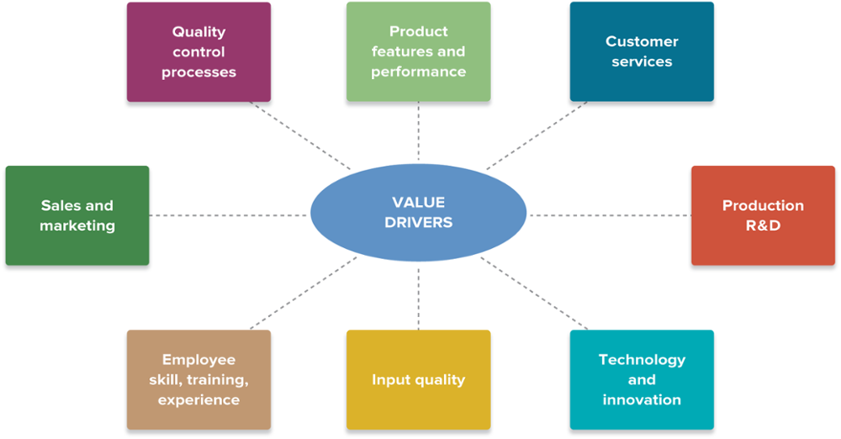
FIGURE 5.3 Value Drivers: The Keys to Creating a Differentiation Advantage
Jump to Appendix 4 long image description

Slide 30
MANAGING THE VALUE CHAIN TO CREATE THE DIFFERENTIATING ATTRIBUTES
Create product features and performance attributes that appeal to a wide range of buyers.
Improve customer service or add extra services.
Invest in production-related R&D activities.
Strive for innovation and technological advances.
Pursue continuous quality improvement.
Increase marketing and brand-building activities.
Seek out high-quality inputs.
Emphasize human resource management activities that improve the skills, expertise, and knowledge of company personnel.

Slide 31


REVAMPING THE VALUE CHAIN SYSTEM TO INCREASE DIFFERENTIATION
Coordinating with channel allies to enhance customer perceptions of value
Approaches to enhancing differentiation through changes in the value chain system
Coordinating with suppliers to better address customer needs
Jump to Appendix 5 long image description

Slide 32
DELIVERING SUPERIOR VALUE VIA A BROAD DIFFERENTIATION STRATEGY
Broad Differentiation: Offering Customers Something That Rivals Cannot
1. | Incorporate product attributes and user features that lower the buyer’s overall costs of using the firm’s product
2. | Incorporate tangible features (e.g., styling) that increase customer satisfaction with the product
3. | Incorporate intangible features (e.g., buyer image) that enhance buyer satisfaction in noneconomic ways
4. | Signal the value of the firm’s product offering to buyers (e.g., price, packaging, placement, advertising)

Slide 33
DIFFERENTIATION: SIGNALING VALUE
Signaling value is important when:
The nature of differentiation is based on intangible features and is therefore subjective or hard to quantify by the buyer.
Buyers are making a first-time purchase and are unsure what their experience will be with the product.
Product or service repurchase by buyers is infrequent.
Buyers are unsophisticated.

Slide 34
STRATEGIC MANAGEMENT PRINCIPLES (6 of 7)
Differentiation can be based on tangible or intangible attributes.
Easy-to-copy differentiating features cannot produce a sustainable competitive advantage.
Any differentiating feature that works well is a magnet for imitators.
Overdifferentiating and overcharging are fatal strategy mistakes.

Slide 35
SUCCESSFUL APPROACHES TO SUSTAINABLE DIFFERENTIATION
Differentiation that is difficult for rivals to duplicate or imitate
Company reputation
Long-standing relationships with buyers
A unique product or service image
Differentiation that creates substantial switching costs that lock in buyers
Patent-protected product innovation
Relationship-based customer service

Slide 36




WHEN A DIFFERENTIATION STRATEGY WORKS BEST
Market Circumstances Favoring Differentiation
Buyer needs and uses for the product are diverse.
There are many ways that differentiation can have value to buyers.
Few rival firms are following a similar differentiation approach
There is rapid change in the product’s technology and features
Jump to Appendix 6 long image description

Slide 37
PITFALLS TO AVOID IN PURSUING A DIFFERENTIATION STRATEGY
Relying on product attributes easily copied by rivals
Introducing product attributes that do not evoke an enthusiastic buyer response
Eroding profitability by overspending on efforts to differentiate the firm’s product offering
Offering only trivial improvements in quality, service, or performance features vis-à-vis the products of rivals
Over-differentiating the product quality, features, or service levels exceeds the needs of most buyers
Charging too high a price premium

Slide 38

FOCUSED (OR MARKET NICHE) STRATEGIES
Focused Strategy Approaches
Focused Low-Cost Strategy
Focused Market Niche Strategy

Slide 39
Clinícas del Azúcar’s Focused Low-Cost Strategy
Which uniqueness drivers are responsible for the success of Clinícas del Azúcar?
Which competitive conditions would mitigate against successful entry of the Clinícas del Azúcar into the U.S. diabetes care market?
What part do customer expectations about patient-doctor relationships play in the delivery of health care in the U.S.?

Slide 40
WHEN A FOCUSED LOW-COST OR FOCUSED DIFFERENTIATION STRATEGY IS ATTRACTIVE
The target market niche is big enough to be profitable and offers good growth potential.
Industry leaders chose not to compete in the niche; focusers avoid competing against strong competitors.
It is costly or difficult for multi-segment competitors to meet the specialized needs of niche buyers.
The industry has many different niches and segments.
Rivals have little or no entry interest in the target segment.

Slide 41
THE RISKS OF A FOCUSED LOW-COST OR FOCUSED DIFFERENTIATION STRATEGY
Competitors will find ways to match the focused firm’s capabilities in serving the target niche.
The specialized preferences and needs of niche members shift over time toward the product attributes desired by the majority of buyers.
As attractiveness of the segment increases, it draws in more competitors, intensifying rivalry and splintering segment profits.

Slide 42
Canada Goose’s Focused Differentiation Strategy
Which decisions did CEO Dani Reiss make that launched Canada Goods on its chosen strategic path?
Which uniqueness drivers are responsible for the success of Canada Goose?
Which of Canada Goose’s uniqueness drivers are competitors likely to attempt to copy first?

Slide 43
BEST-COST PROVIDER STRATEGIES
Differentiation: Providing desired quality, features, performance, service attributes
Low Cost Provider: Charging a lower price than rivals with similar caliber product offerings
Best-Cost Provider Hybrid Approach
Value-Conscious Buyer
Jump to Appendix 7 long image description

Slide 44
Core Concept (5 of 5)
Best-cost provider strategies are a hybrid of low-cost provider and differentiation strategies that aim at providing more desirable attributes (quality, features, performance, service) while beating rivals on price.

Slide 45
WHEN A BEST-COST PROVIDER STRATEGY WORKS BEST
Product differentiation is the market norm.
There are a large number of value-conscious buyers who prefer mid-range products.
There is competitive space near the middle of the market for a competitor with either a medium-quality product at a below-average price or a high-quality product at an average or slightly higher price.
Economic conditions have caused more buyers to become value-conscious.

Slide 46
THE RISK OF A BEST-COST PROVIDER STRATEGY—GETTING SQUEEZED ON BOTH SIDES
Best-Cost Provider Strategy
Low-Cost Providers
High-End Differentiators

Slide 47
American Giant’s Best-Cost Provider Strategy
How can product quality lower product costs?
In which stages of an industry life cycle are low-cost leadership, differentiation, focused niche, and best-cost provider strategies most appropriate?
Could the higher-selling prices of American Giant’s clothing versus its competitors be used as a proxy for measuring the strength of its best-cost strategy?

Slide 48
THE CONTRASTING FEATURES OF THE FIVE GENERIC COMPETITIVE STRATEGIES: A SUMMARY
Each generic strategy:
Positions the firm differently in its market
Establishes a central theme for how the firm intends to outcompete rivals
Creates boundaries or guidelines for strategic change as market circumstances unfold
Entails different ways and means of maintaining the basic strategy

Slide 49
Table 5.1 Distinguishing Features of the Five Generic Competitive Strategies (1 of 2)
 | Low-Cost Provider | Broad Differentiation | Focused low-cost provider | Focused differentiation | Best-Cost Provider
Strategic target | A broad cross-section of the market | A broad cross-section of the market | A narrow market niche where buyer needs and preferences are distinctively different | A narrow market niche where buyer needs and preferences are distinctively different | Value-conscious buyers. Or, a middle-market range
Basis of competitive strategy | Lower overall costs than competitors | Ability to offer buyers something attractively different from competitors’ offerings | Lower overall cost than rivals in serving niche members | Attributes that appeal specifically to niche members | Ability to offer better goods at attractive prices
Product line | A good basic product with few frills (acceptable quality and limited selection) | Many product variations, wide selection, emphasis on differentiating features | Features and attributes tailored to the tastes and requirements of niche members | Features and attributes tailored to the tastes and requirements of niche members | Items with appealing attributes and assorted features; better quality, not best
Production emphasis | A continuous search for cost reduction without sacrificing acceptable quality and essential features | Build in whatever differentiating features buyers are willing to pay for; strive for product superiority | A continuous search for cost reduction for products that meet basic needs of niche members | Small-scale production or custom-made products that match the tastes and requirements of niche members | Build in appealing features and better quality at lower cost than rivals

Slide 50
Table 5.1 Distinguishing Features of the Five Generic Competitive Strategies (2 of 2)
 | Low-Cost Provider | Broad Differentiation | Focused low-cost provider | Focused differentiation | Best-Cost Provider
Marketing emphasis | Low prices, good value Also, try to make a virtue out of product features that lead to low cost | Tout differentiating features. Also, charge a premium price to cover the extra costs of differentiating features | Communicate attractive features of a budget-priced product offering that fits niche buyers’ expectations | Communicate how product offering does the best job of meeting niche buyers’ expectations | Emphasize delivery of best value for the money
Keys to maintaining the strategy | Economical prices, good value Also, strive to manage costs down, year after year, in every area of the business | Stress constant innovation to stay ahead of imitative competitors Also, concentrate on a few key differentiating features. | Stay committed to serving the niche at the lowest overall cost; don’t blur the firm’s image by entering other market segments or adding other products to widen market appeal | Stay committed to serving the niche better than rivals; don’t blur the firm’s image by entering other market segments or adding other products to widen market appeal. | Unique expertise in simultaneously managing costs down while incorporating upscale features and attributes
Resources and capabilities required | Capabilities for driving costs out of the value chain syste. Examples: large-scale automated plants, an efficiency-oriented culture, bargaining power | Capabilities concerning quality, design, intangibles, and innovation Examples: marketing capabilities, R&D teams, technology | Capabilities to lower costs on niche goods Examples: Lower input costs for the specific product desired by the niche, batch production capabilities | Capabilities to meet the highly specific needs of niche members Examples: custom production, close customer relations. | Capabilities to simultaneously deliver lower cost and higher-quality or differentiated feature Examples: TQM practices, mass customization

Slide 51
SUCCESSFUL COMPETITIVE STRATEGIES ARE RESOURCE-BASED
A firm’s competitive strategy is most likely to succeed if it is predicated on leveraging a competitively valuable collection of resources and capabilities that match the strategy.
Sustaining a firm’s competitive advantage depends on its resources, capabilities, and competences that are difficult for rivals to duplicate and have no good substitutes.

Slide 52
Strategic Management Principle (7 of 7)
A company’s competitive strategy should be well-matched to its internal situation and predicated on leveraging its collection of competitively valuable resources and capabilities.

Slide 53
Appendix 1 Why Do Strategies Differ?
Two key factors that distinguish one strategy from another
Is the firm's market target broad or narrow?
Is the competitive advantage pursued linked to low costs or product differentiation?
Return to slide

Slide 54
Appendix 2 Figure 5.1 The Five Generic Competitive Strategies
The illustration lists two types of competitive advantages being pursued: lower cost and differentiation. It also lists two market targets: a broad cross-section of buyers, and a narrow buyer segment (or market niche). The combination of these types creates the five generic strategies:
Overall low-cost provider strategy (lower cost or a broad cross-section of buyers)
Focused low-cost strategy (lower cost or a narrow buyer segment)
Broad differentiation strategy (differentiation or a broad cross-section of buyers)
Focused differentiation strategy (differentiation or a narrow buyer segment)
Best-Cost Provider strategy (an equal balance of competitive advantages and market targets)
Return to slide

Slide 55
Appendix 3 Figure 5.2 Cost Drivers: The Keys to Driving Down Company Costs
The cost drivers listed are:
Incentive systems and culture; economies of scale; learning and experience; capacity utilization; supply chain efficiencies; input costs; production technology and design; communication systems and information technology; bargaining power; and outsourcing or vertical integration.
Return to slide

Slide 56
Appendix 4 Figure 5.3 Value Drivers: The Keys to Creating a Differentiation Advantage
The value drivers listed are: quality control processes; product features and performance; customer services; production R&D; technology and innovation; input quality; employee skill, training, experience; and sales and marketing.
Return to slide

Slide 57
Appendix 5 Revamping the Value Chain System to Increase Differentiation
The two approaches to enhancing differentiation through changes in the value chain system are:
Coordinating with channel allies to enhance customer perceptions of value
Coordinating with suppliers to better address customer needs
Return to slide

Slide 58
Appendix 6 When a Differentiation Strategy Works Best
The four market circumstances that favor differentiation are:
Diversity of buyer needs and uses for the product
Many ways that differentiation can have value to buyers
Few rival firms follow a similar differentiation approach
Rapid change in technology and product features
Return to slide

Slide 59
Appendix 7 Best-Cost Provider Strategies
A combination of differentiation (providing desired quality, features, performance, service attributes) and low-cost provider (charging a lower price than rivals with similar caliber product offerings) leads to the best-cost provider hybrid approach, which connects with the value-conscious buyer.
Return to slide

